Slide 1
Normal distribution

Slide 2
REMEMBER your box plot
Middle 50%
LQ
UQ
range

Slide 3
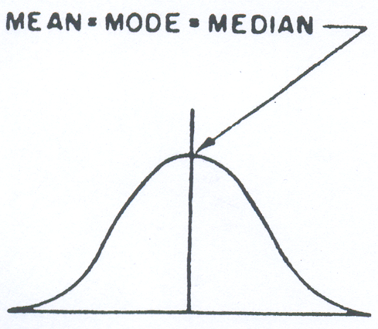
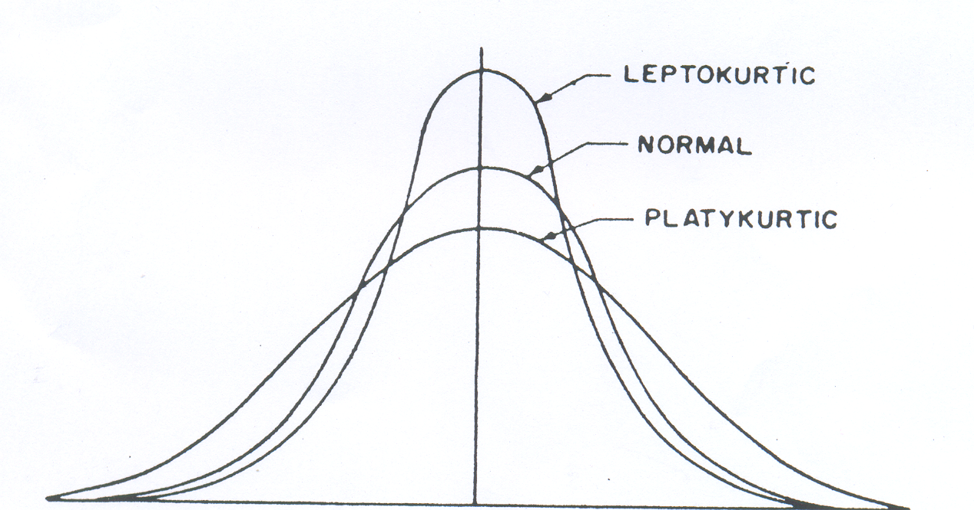
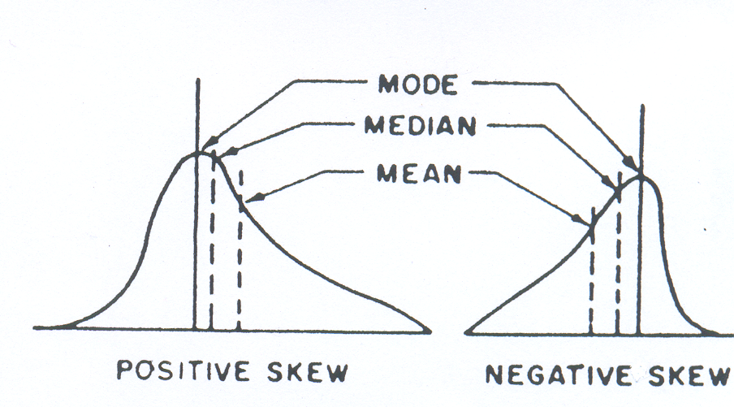

Slide 4
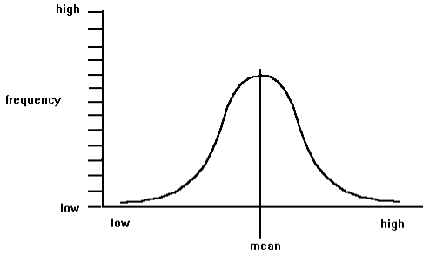
The Normal Distribution:
The Normal curve is a mathematical abstraction which conveniently describes ("models") many frequency distributions of scores in real-life.

Slide 5
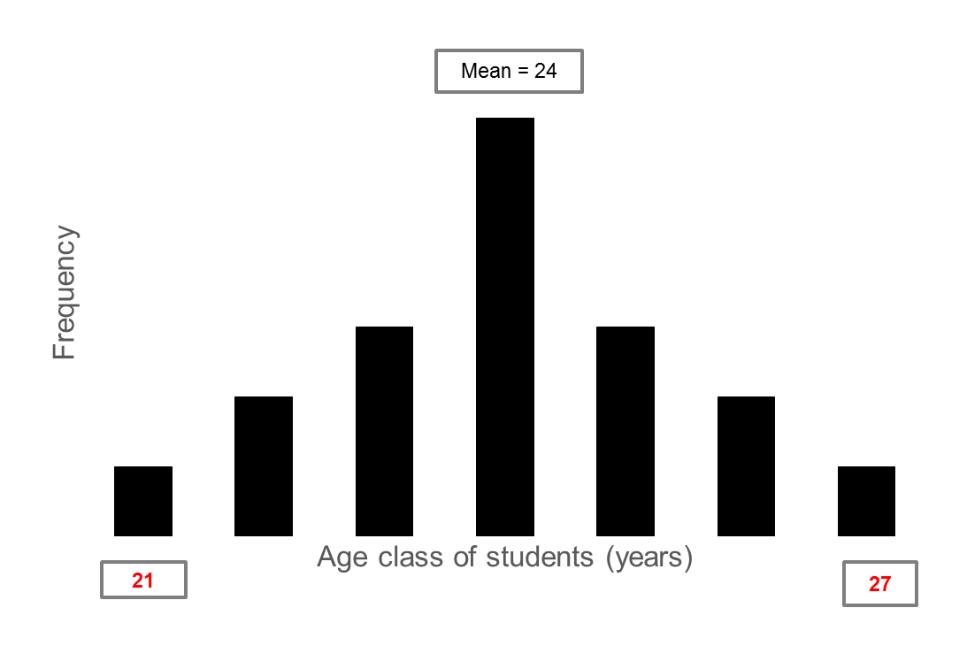
21
22
22
23
23
23
24
24
24
24
24
24
25
25
25
26
26
27
Normal Distribution
Mean = 24
SD = 1.53

Slide 6
Properties of the Normal Distribution:
1. It is bell-shaped.

Slide 7
2. It's symmetrical around the mean.

Slide 8
3. The mean, median and mode all have same value.

Slide 9
4. It can be specified completely, once mean and SD are known.

Slide 10
5. The area under the curve is directly proportional to the relative frequency of observations.

Slide 11
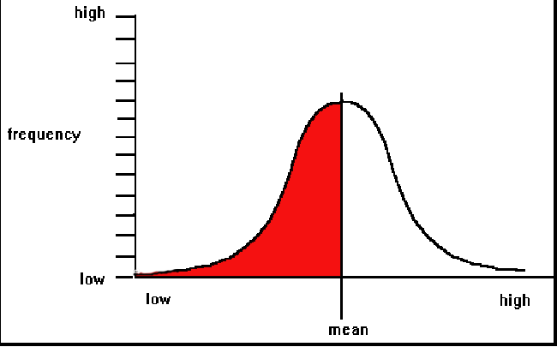
50% or 0.5
50% or 0.5
Area under the curve = o.5 + 0.5 = 1
e.g. in the figure above, 50% of scores fall below the mean, and the other 50% of the data fall above the mean (of the area under the curve).

Slide 12
Normal distributions
An important class of density curves are the symmetric unimodal bell-shaped curves known as normal curves and the type of distributions are called normal distributions.
All normal distributions have the same overall shape.
The exact density curve for a particular normal distribution is specified by giving its mean μ (mu) and its standard deviation σ (sigma).
The mean is located at the center of the symmetric curve and is the same as the median and the mode.

Slide 13
Normal Distributions
A Normal distribution is described by a Normal density curve. Any particular Normal distribution is completely specified by two numbers: its mean µ and standard deviation σ.
  The mean of a Normal distribution is the center of the symmetric Normal curve.
  The standard deviation is the distance from the center to the change-of-curvature points on either side, the points of inflection of the density.
  We abbreviate the Normal distribution with mean µ and standard deviation σ as N(µ,σ).

Slide 14
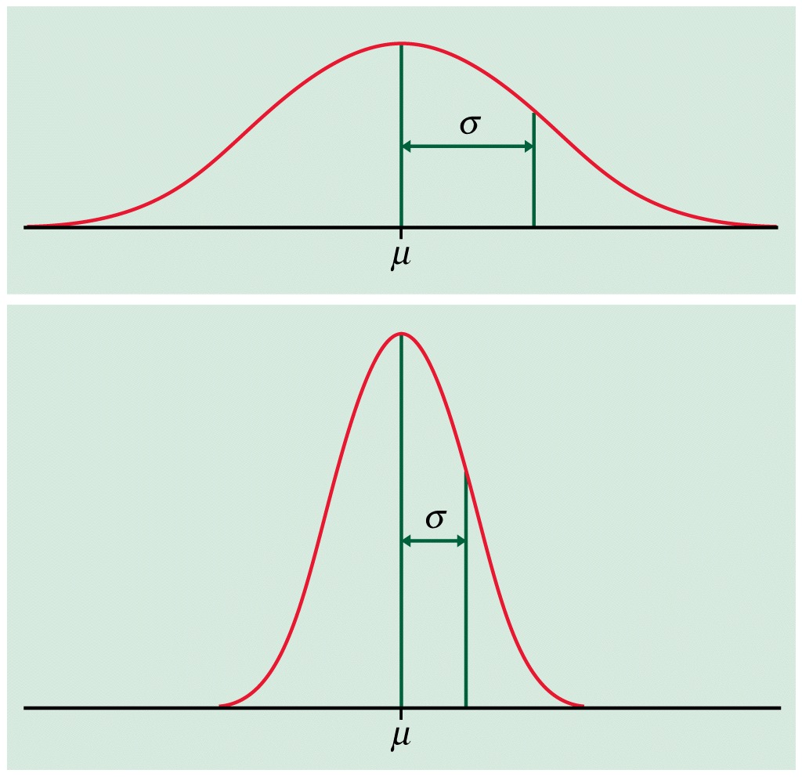
The standard deviation σ controls the spread of a normal curve.

Slide 15
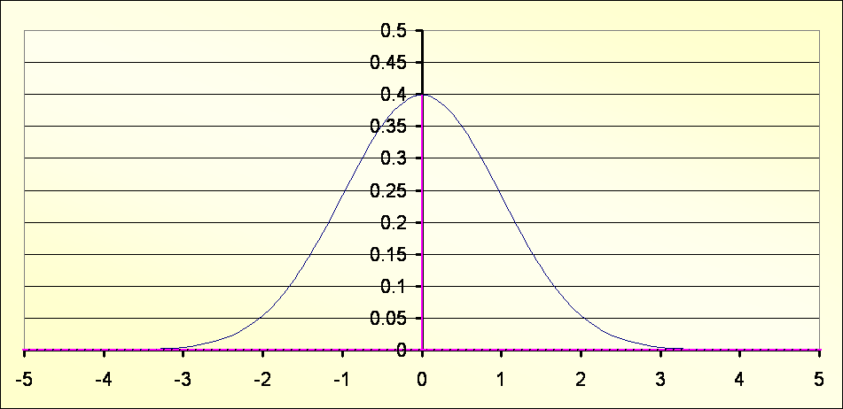
The normal distribution is a theoretical probability (the area under the curve adds up to one)

Slide 16
A Normal distribution is a theoretical model of the whole population. It is perfectly symmetrical about the central value; the mean μ represented by zero.

Slide 17
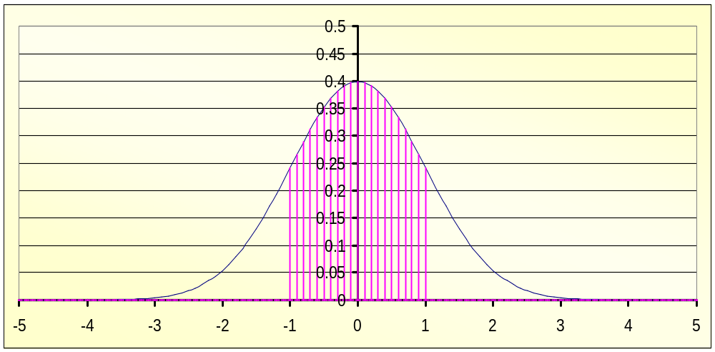
As well as the mean the standard deviation (σ) must also be known.
The X axis is divided up into deviations from the mean: Below the shaded area is one deviation from the mean.

Slide 18
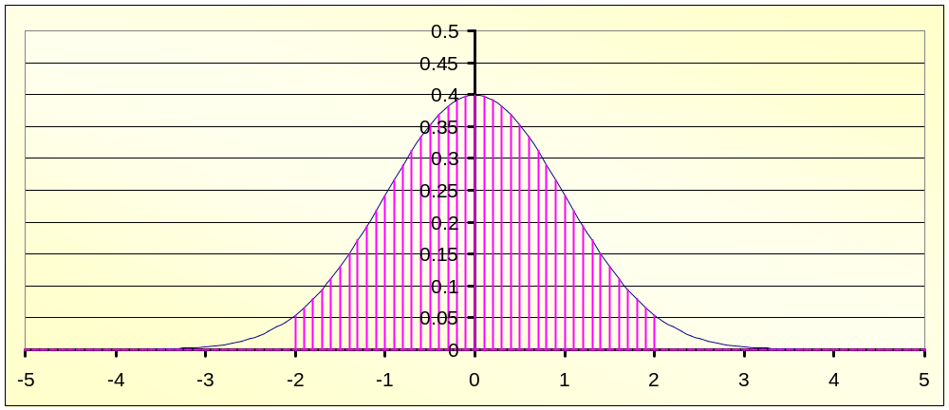
Two standard deviations from the mean

Slide 19
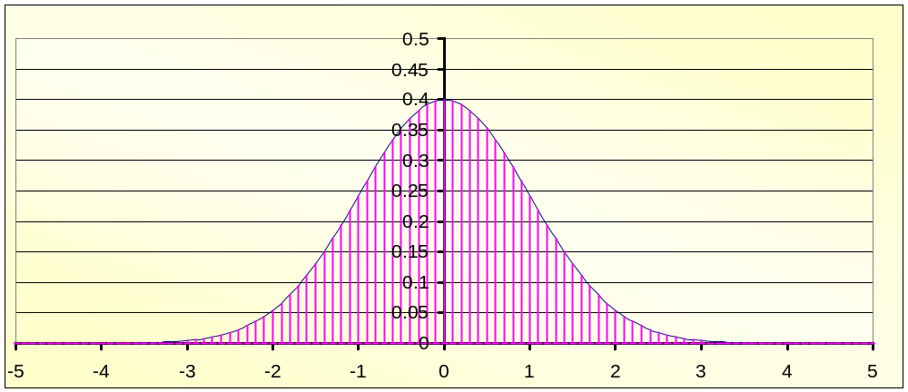
Three standard deviations from the mean

Slide 20
Empirical Rule for a set of normal data: 68% of data will fall within 1σ of the μ
P( | -1 | < | z | < | 1 | ) | = | 0.683 | = | 68.3%

Slide 21
95% of data fits within 2σ of the μ
P( | -2 | < | z | < | 2 | ) | = | 0.954 | = | 95.4%

Slide 22
99.7% of data fits within 3σ of the μ
P( | -3 | < | z | < | 3 | ) | = | 0.997 | = | 99.7%

Slide 23
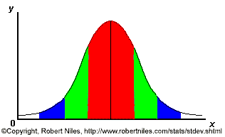
68%; 95%; 99.7% Rule
68% of the data
95% of the data
99.7% of the data
Notes:
SAY: within 1 standard deviation either way of the mean
within 2 standard deviations of the mean
within 3 standard deviations either way of the mean
WORKS FOR ALL NORMAL CURVES NO MATTER HOW SKINNY OR FAT

Slide 24
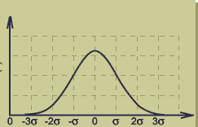
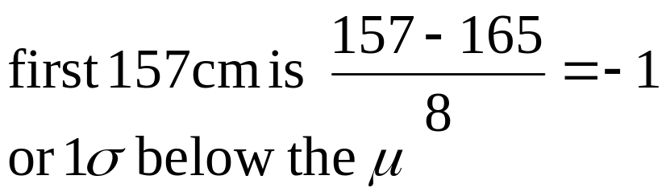
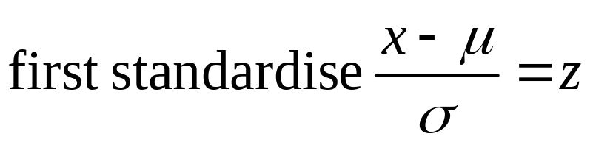
Simple problems can be solved using the imperial rule
<-3 | -3 to -2 | -2 to -1 | -1 to 0 | 0 to 1 | 1 to 2 | 2 to 3 | >3
0% | 2% | 14% | 34% | 34% | 14% | 2% | 0%
The heights of students at a college were found to follow a bell-shaped distribution with μ of 165cm and σ of 8 cm.
What proportion of students are smaller than 157 cm
16%

Slide 25
What is a z-scores?

Slide 26
Z scores
When a set of data values are normally distributed, we can standardize each score by converting it into a z-score.
z-scores make it easier to compare data values measured on different scales.
A z-score reflects how many standard deviations above or below the mean a raw score is.
The z-score is positive if the data value lies above the mean and negative if the data value lies below the mean.

Slide 27
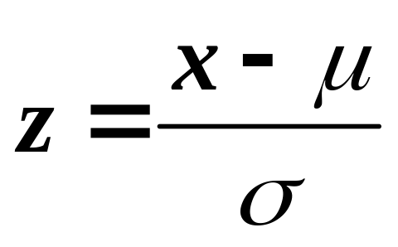
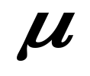

z-score formula
Where x represents an element of the data set, the mean is represented by and standard deviation by .

Slide 28
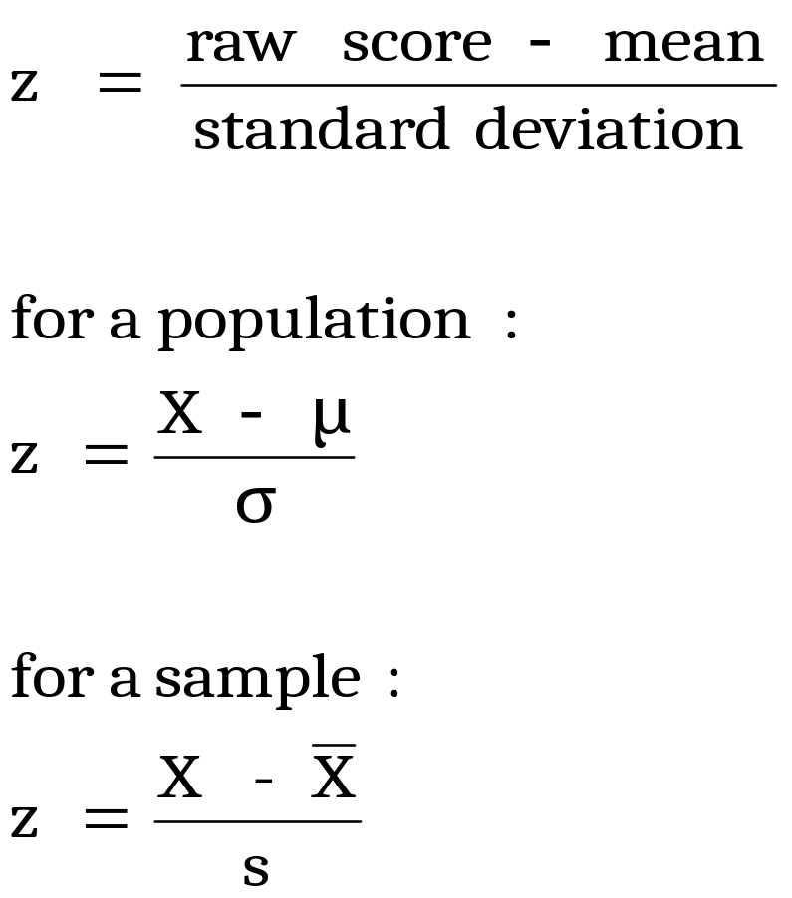
z-scores are "standard scores“ that states the position of a raw score in relation to the mean of the distribution, using the standard deviation as the unit of measurement.
Find the difference between a score and the mean of the set of scores.
2. Divide this difference by the Standard Deviation (in order to assess how big it really is).

Slide 29
Density curves, Z Score and Z tables

Slide 30
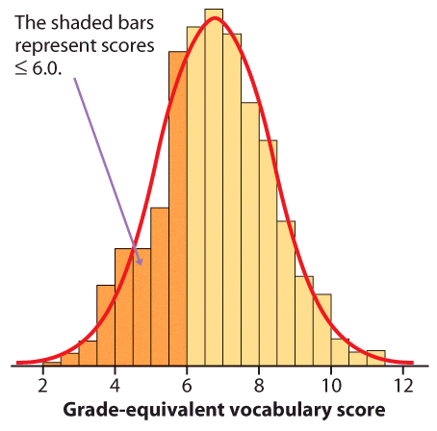
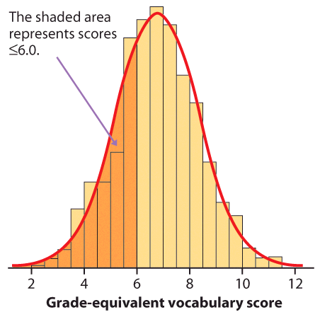
Density curves
A density curve is a mathematical model of a distribution.
The total area under the curve, by definition, is equal to 1, or 100%.
The area under the curve for a range of values is the proportion of all observations for that range.
Area under Density Curve ~ Relative Frequency of Histogram
Histogram of a sample with the smoothed, density curve describing theoretically the population.
rel. freq of left histogram=287/947=.303
area = .293 under rt. curve

Slide 31
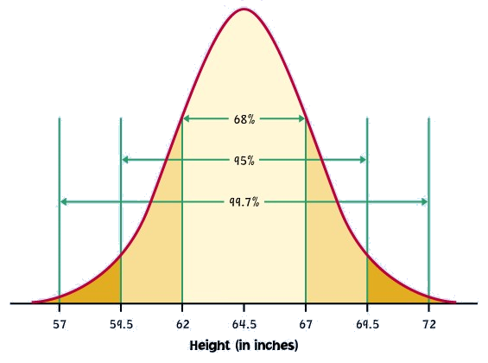
The 68-95-99.7 Rule
In the Normal distribution with mean µ and standard deviation σ:
  Approximately 68% of the observations fall within σ of µ.
  Approximately 95% of the observations fall within 2σ of µ.
  Approximately 99.7% of the observations fall within 3σ of µ.
Here’s a N(64.5”, 2.5”)
distribution of heights of
college-aged females.

Slide 32
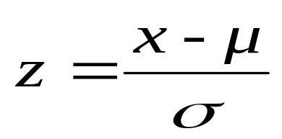
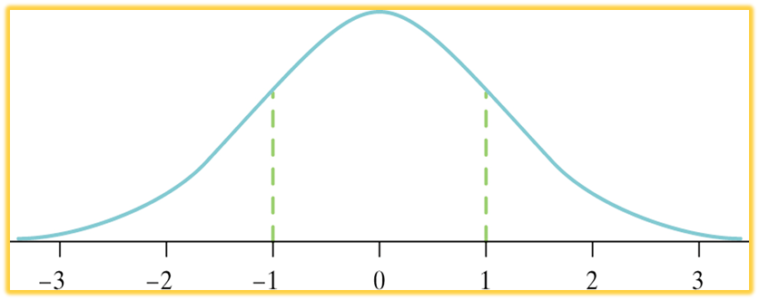
Standardizing Observations
If a variable x has a distribution with mean µ and standard deviation σ, then the standardized value of x, or its z-score, is
All Normal distributions are the same if we measure in units of size σ from the mean µ as center.
The standard Normal distribution is the Normal distribution with mean 0 and standard deviation 1. That is, the standard Normal distribution is N(0,1) – it is represented by Z and we write Z ~ N(0,1)

Slide 33
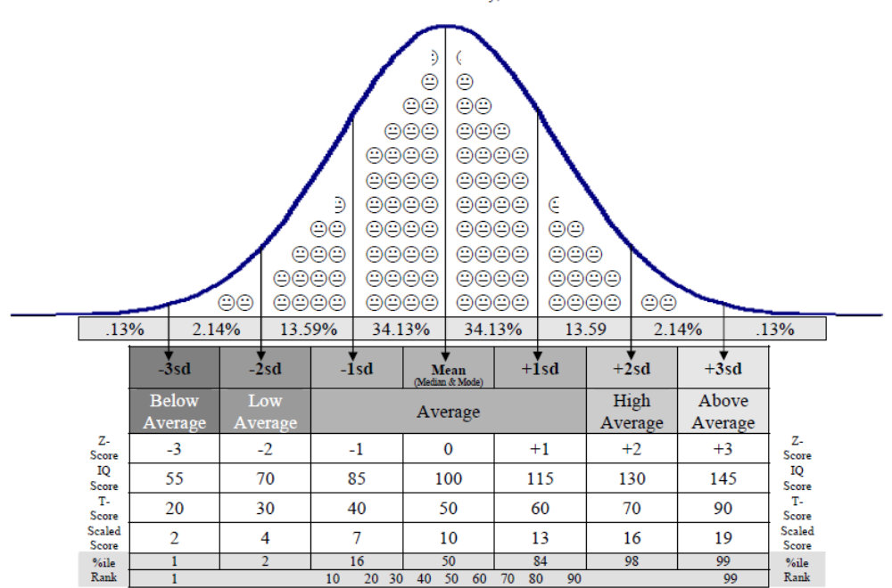

Slide 34
Relationship between the normal curve and the standard deviation

Slide 35
Relationship between the normal curve and the standard deviation
95% of the area (or .95 probability values) lie within the 2 Standard Deviation from the mean (see below)
frequency
68%
95%
99.7%
SD = -3
SD = +3
SD = 0
-3 -2 -1 mean +1 +2 +3
Number of standard deviations (either side of mean)

Slide 36
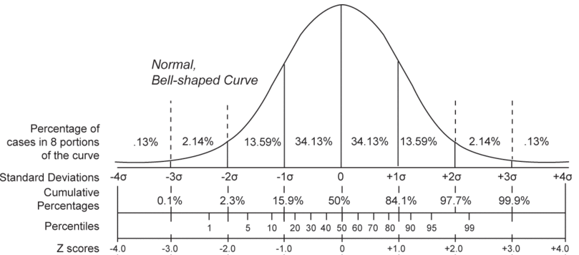
Relationship between σ, µ, and other functions are graphically presented in a graphical form

